Slide 1
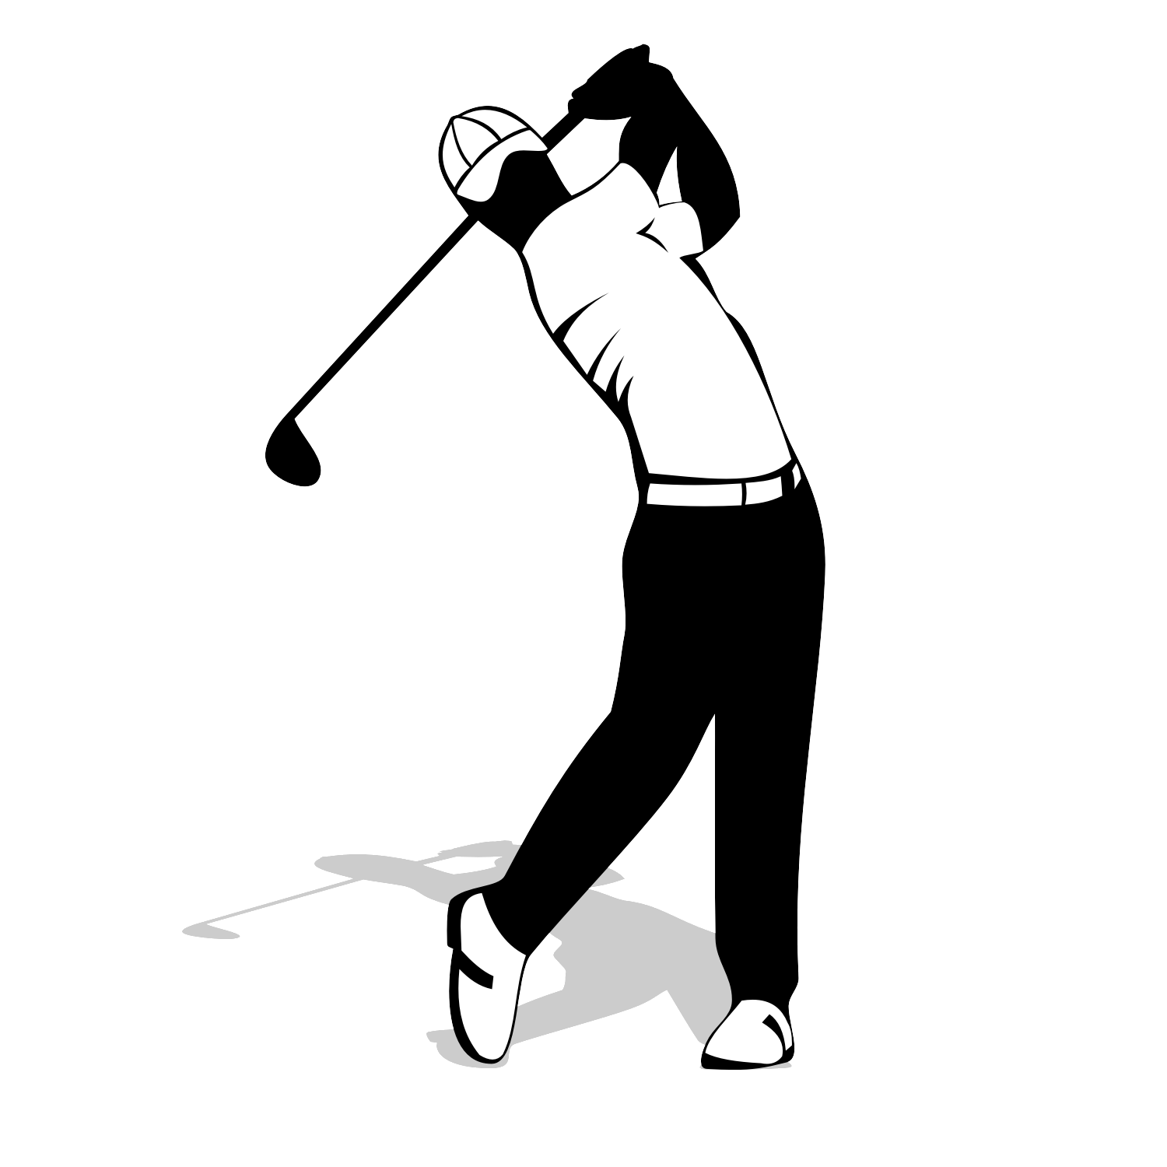
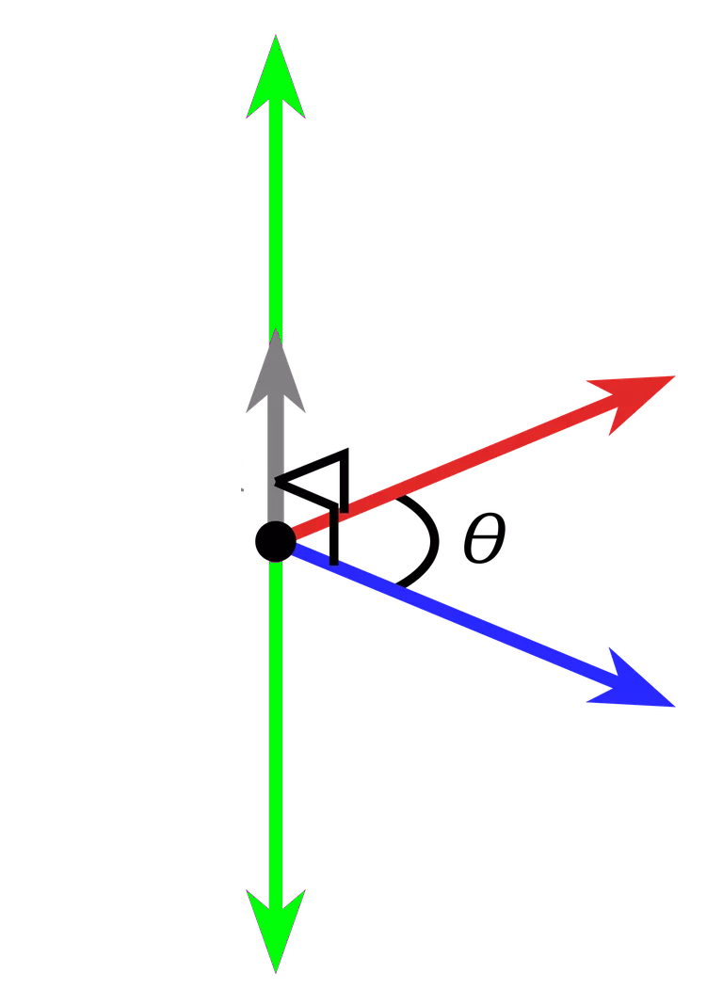

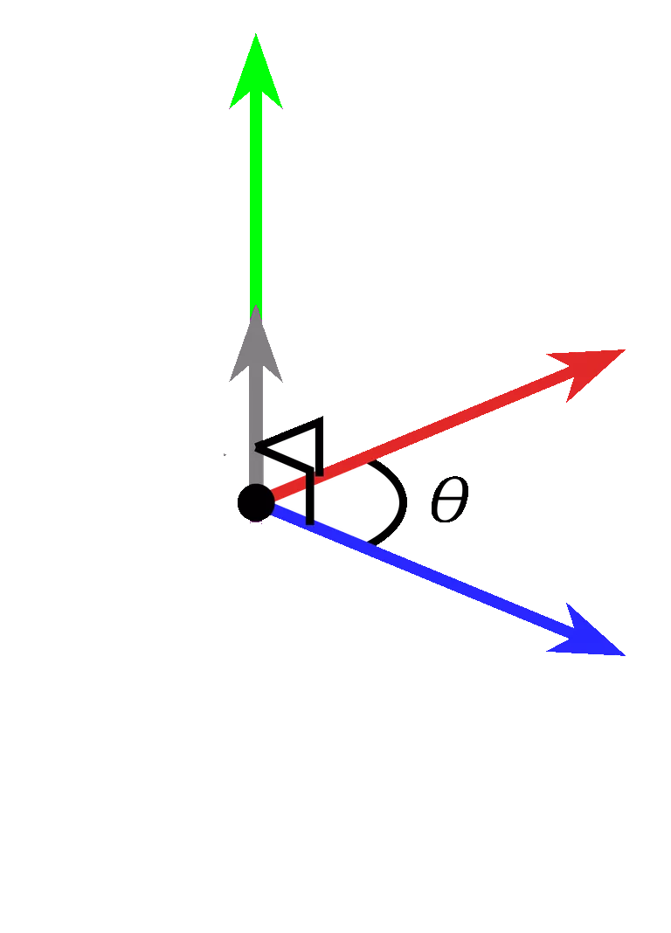
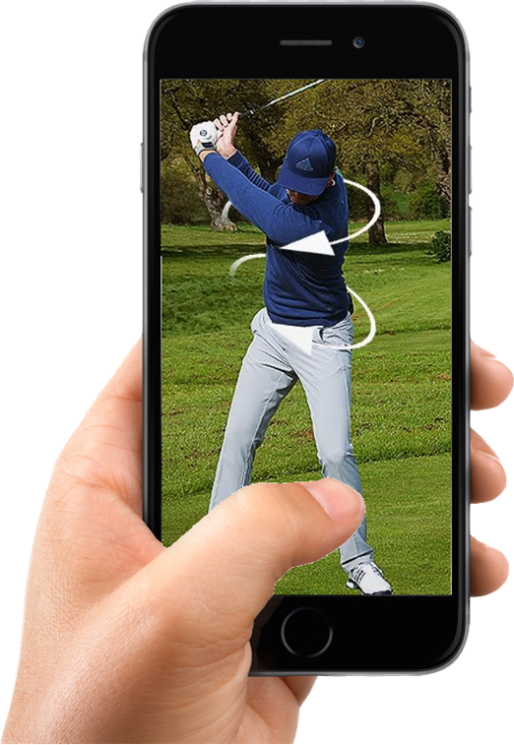
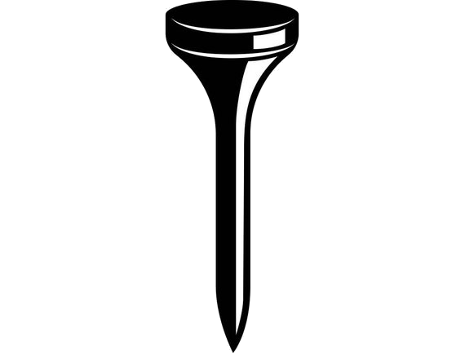
Golf Glove
Notes:
Good afternoon. My name is Christian Bush and I am the team lead for Golf Glove. As far as development, I work on the coaching application and bluetooth reception.

Slide 2
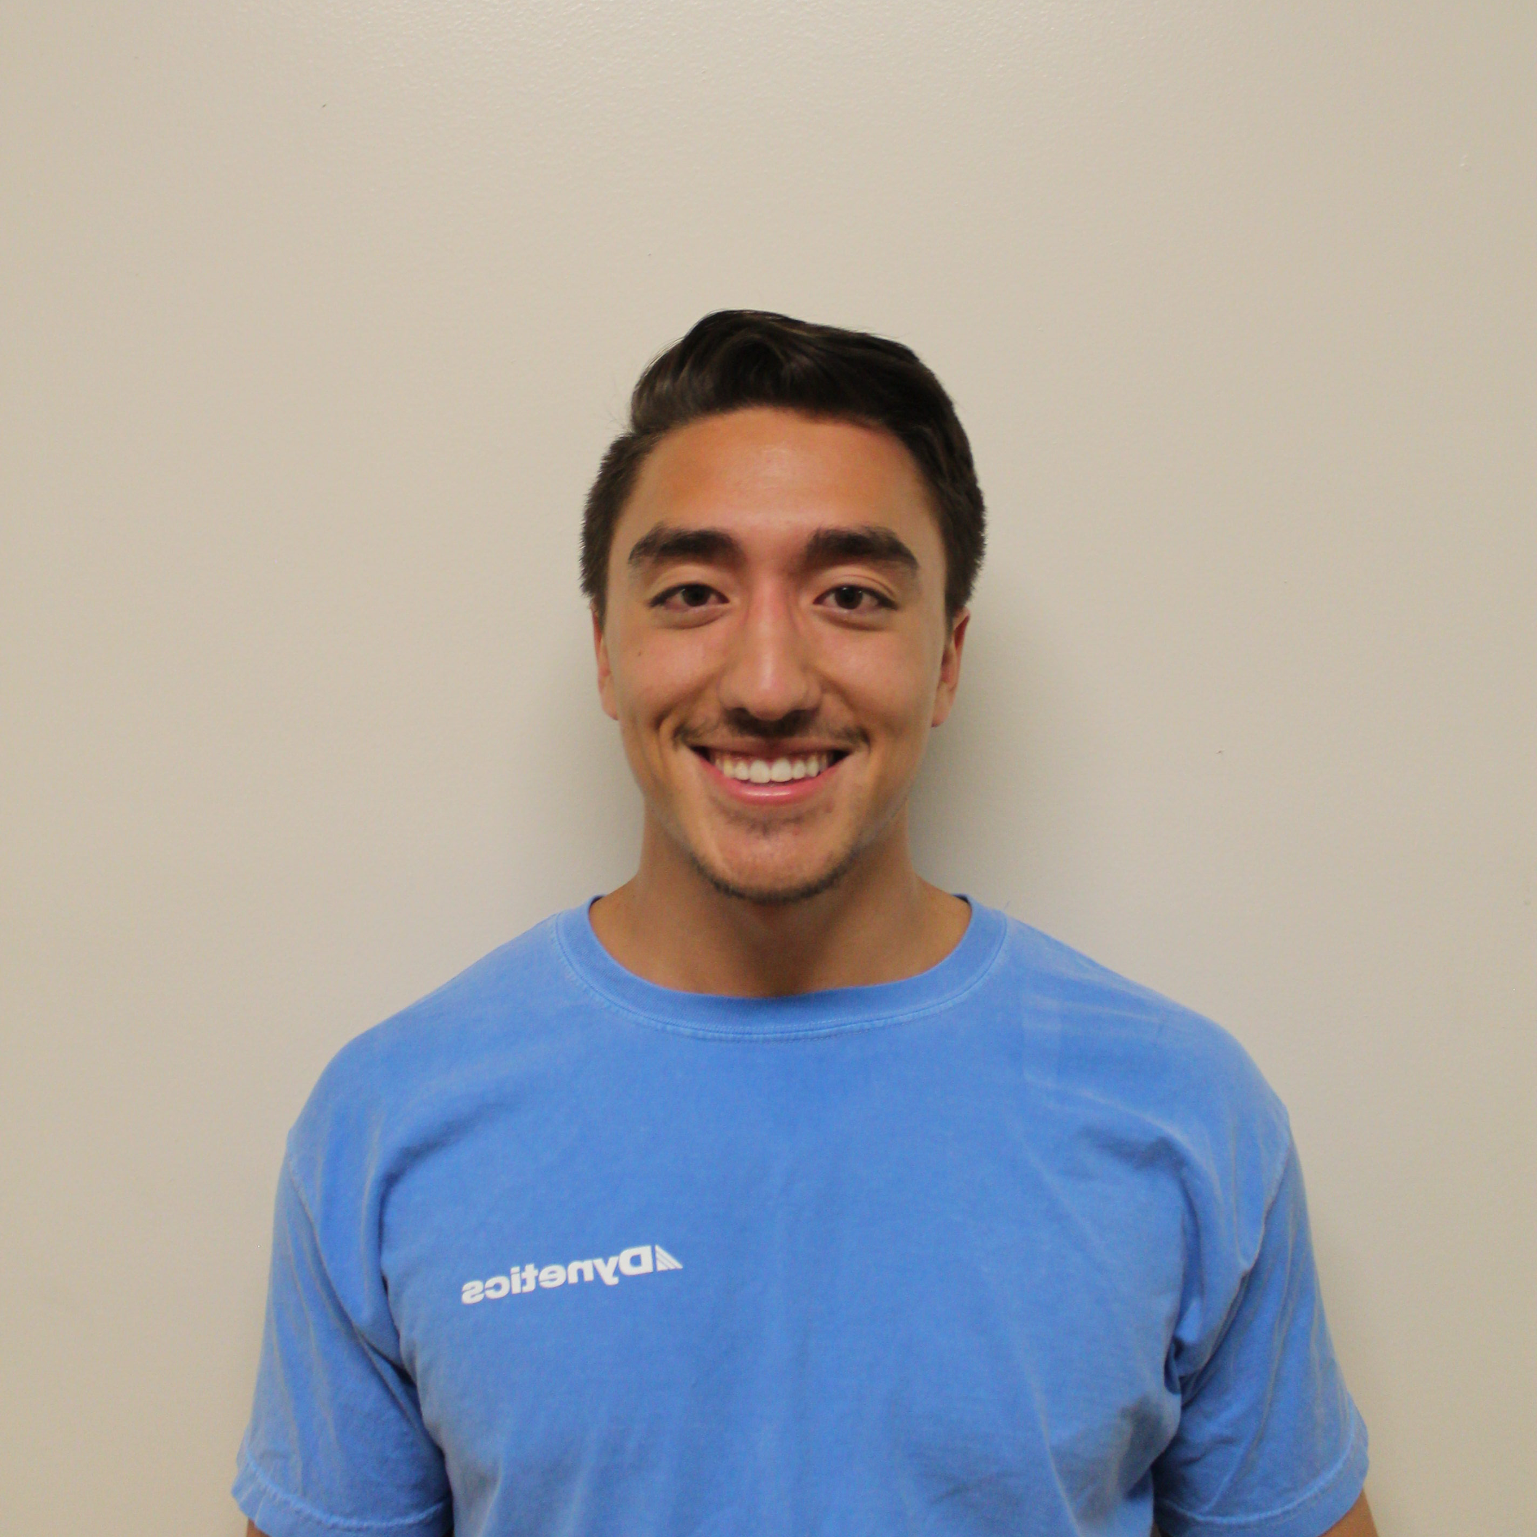
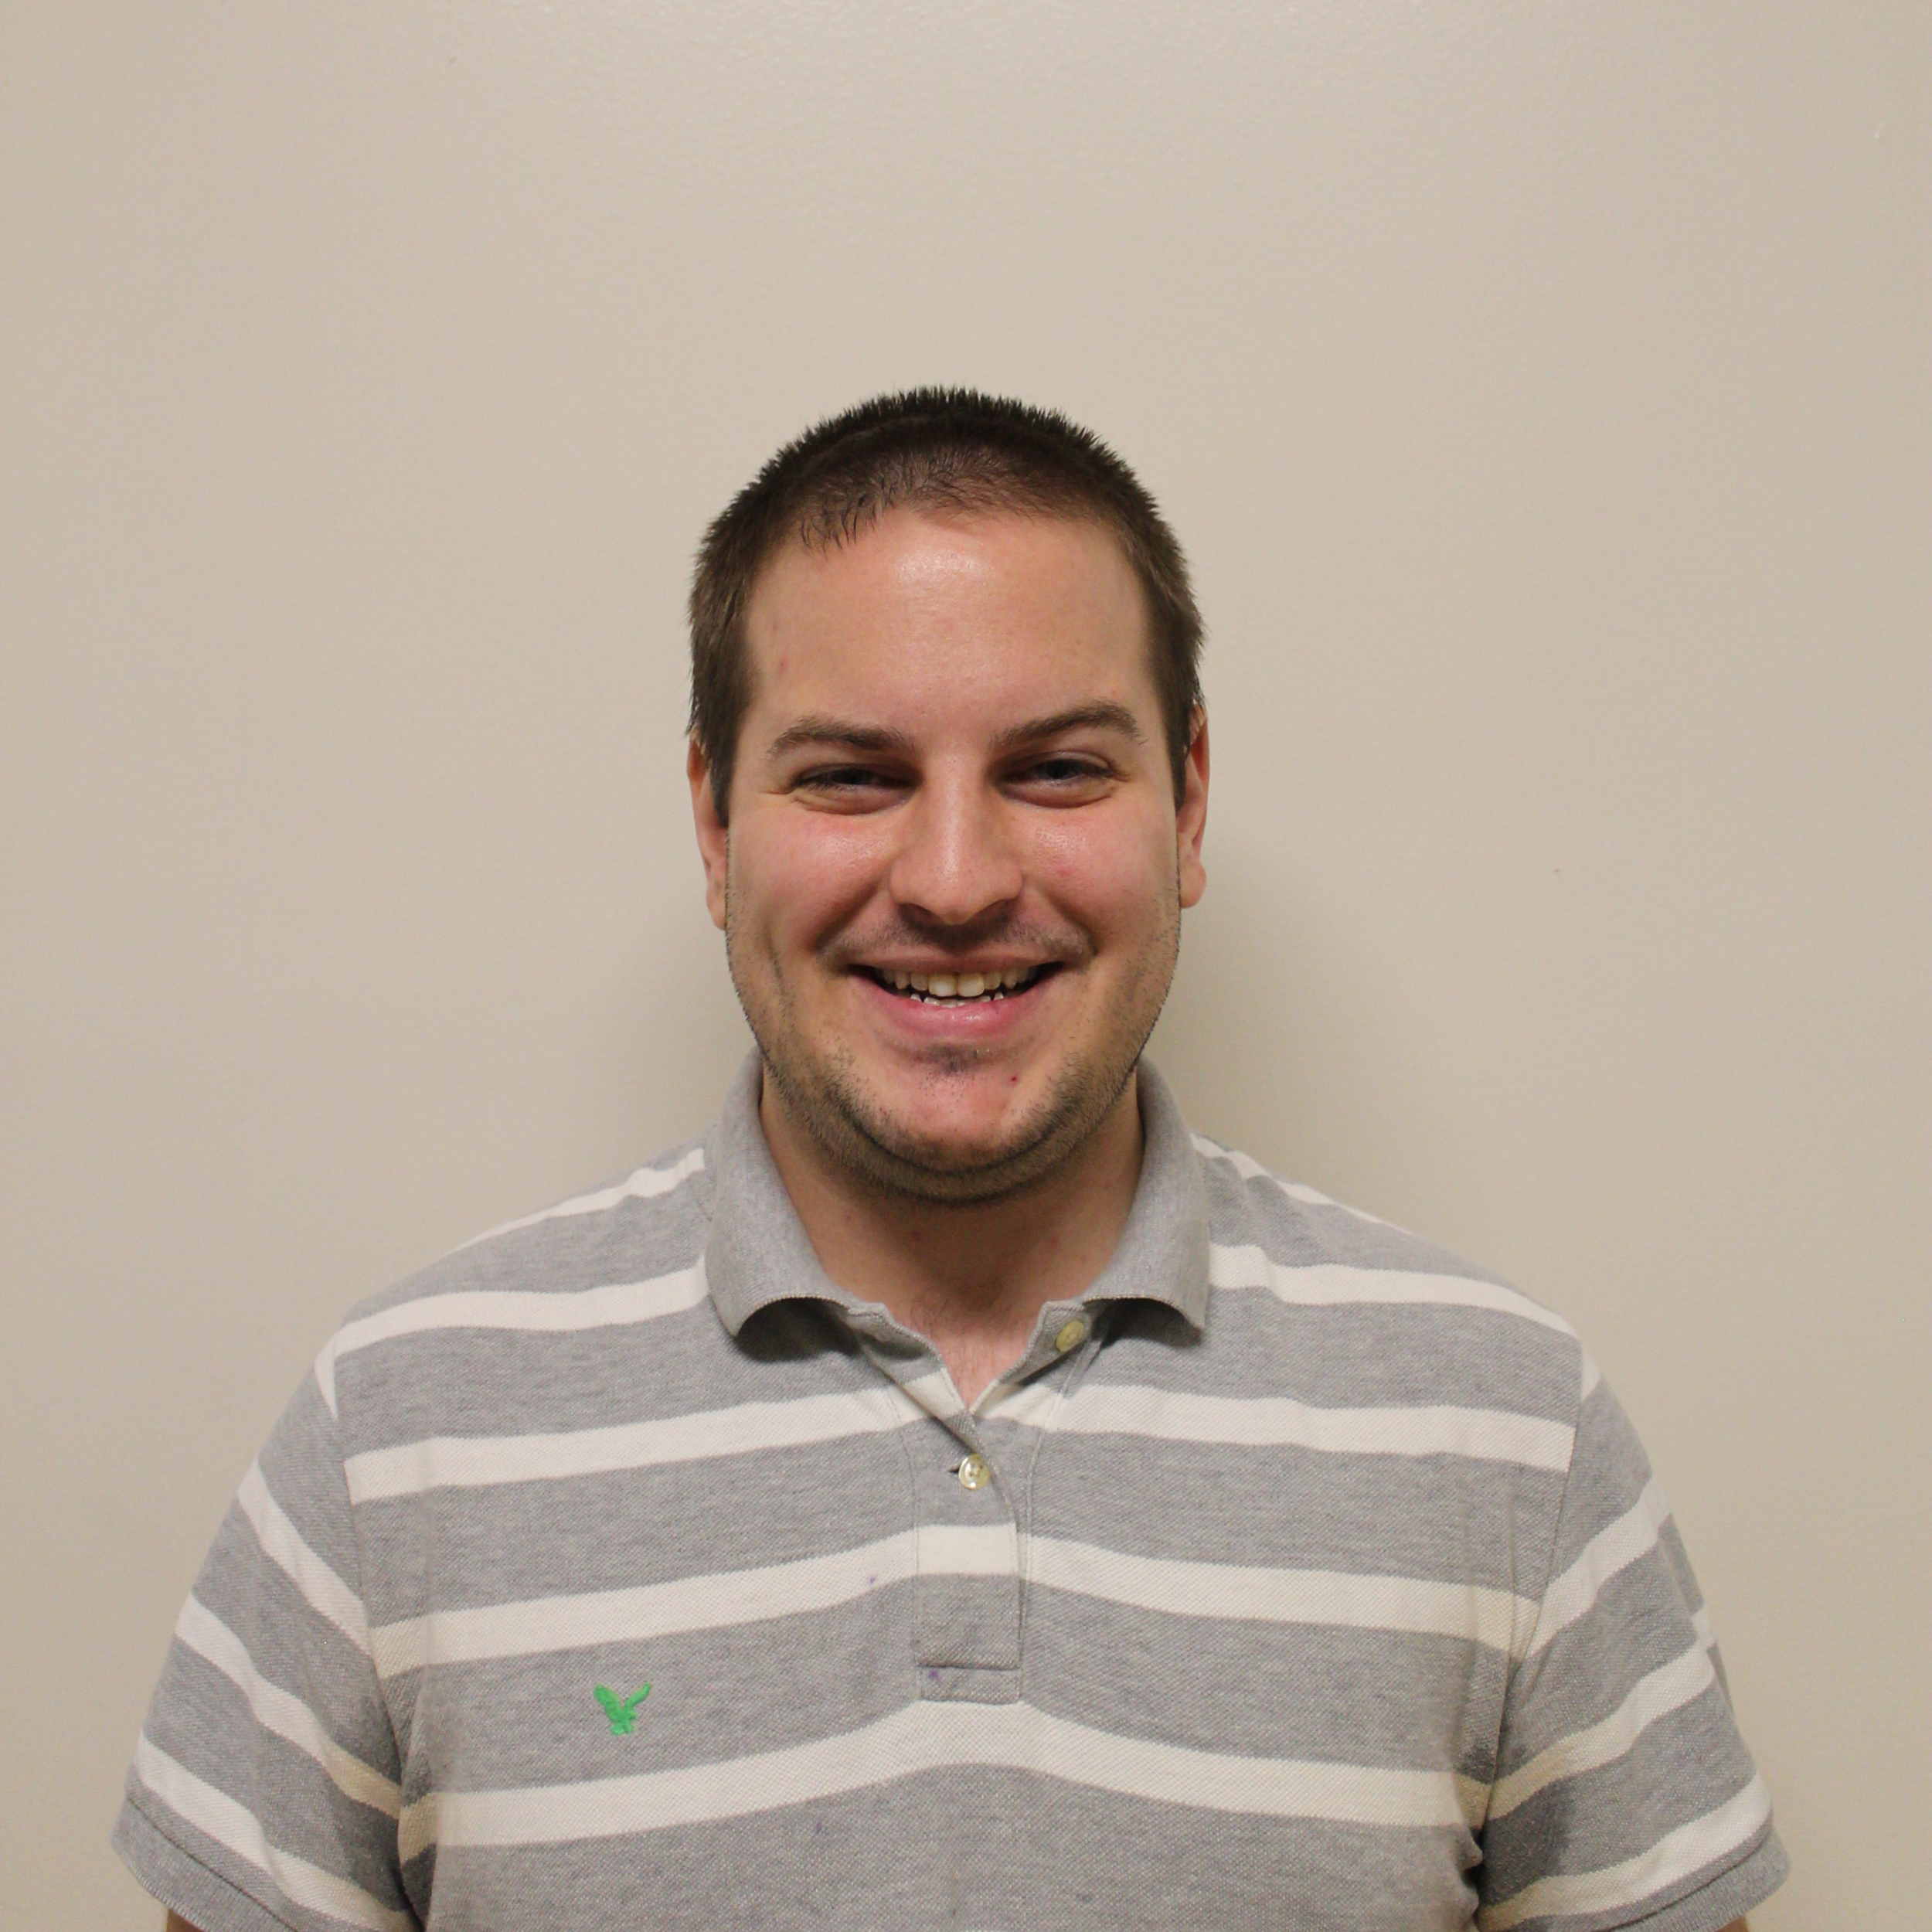
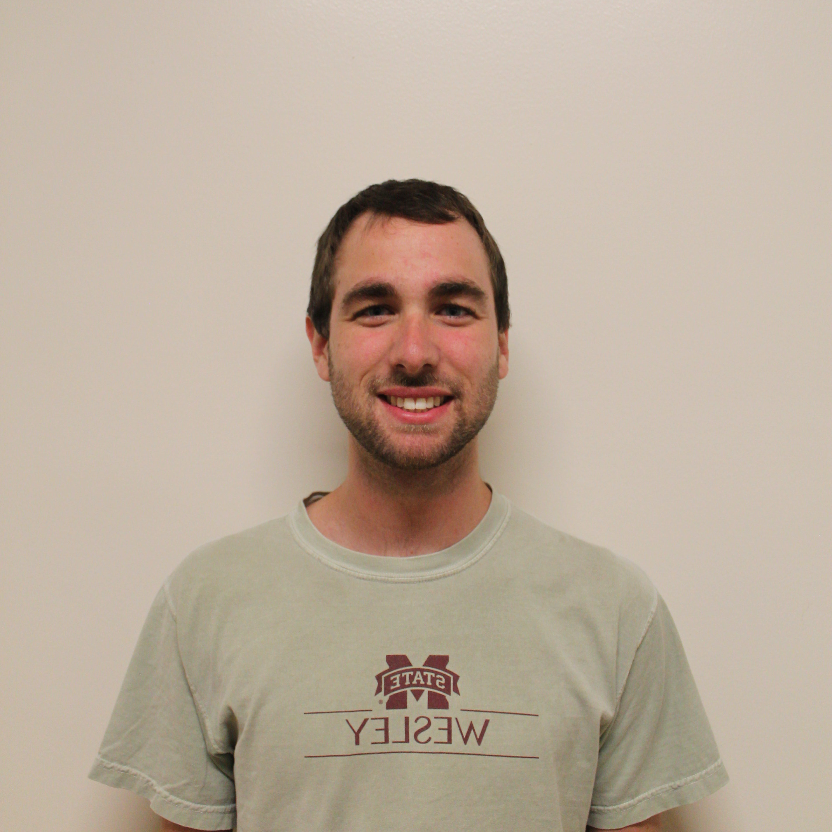
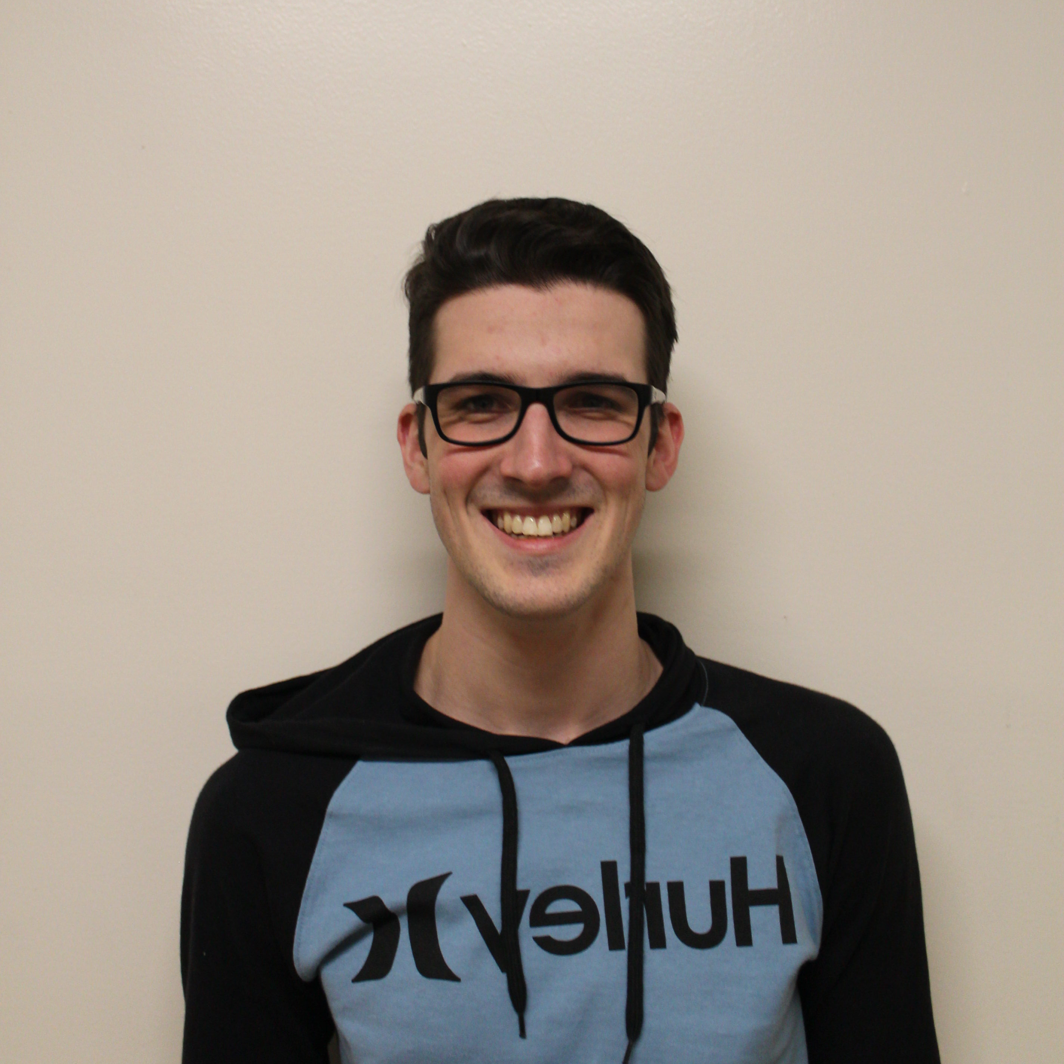
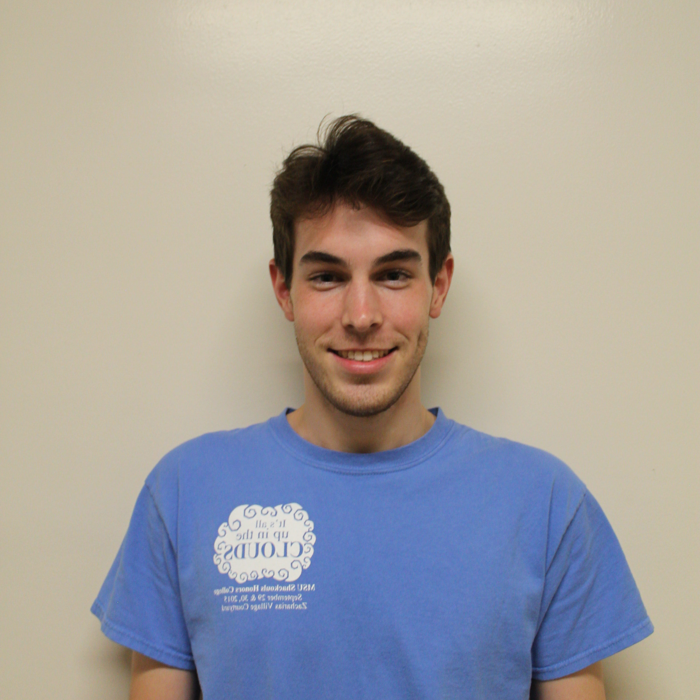
Team
Christian Bush
Computer Engineering
Software
Spencer Callicott
Computer Engineering
Firmware
Will Carroll
Computer Engineering Firmware
Landon Casey
Computer Engineering
Hardware
Jack Fletcher
Computer Engineering
Software

Slide 3
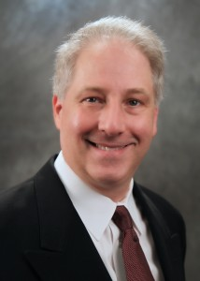
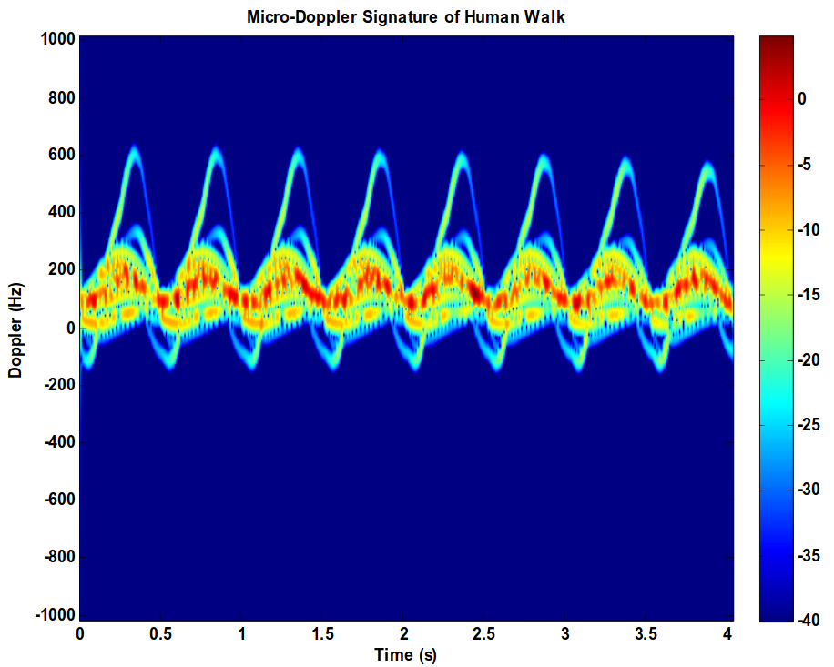
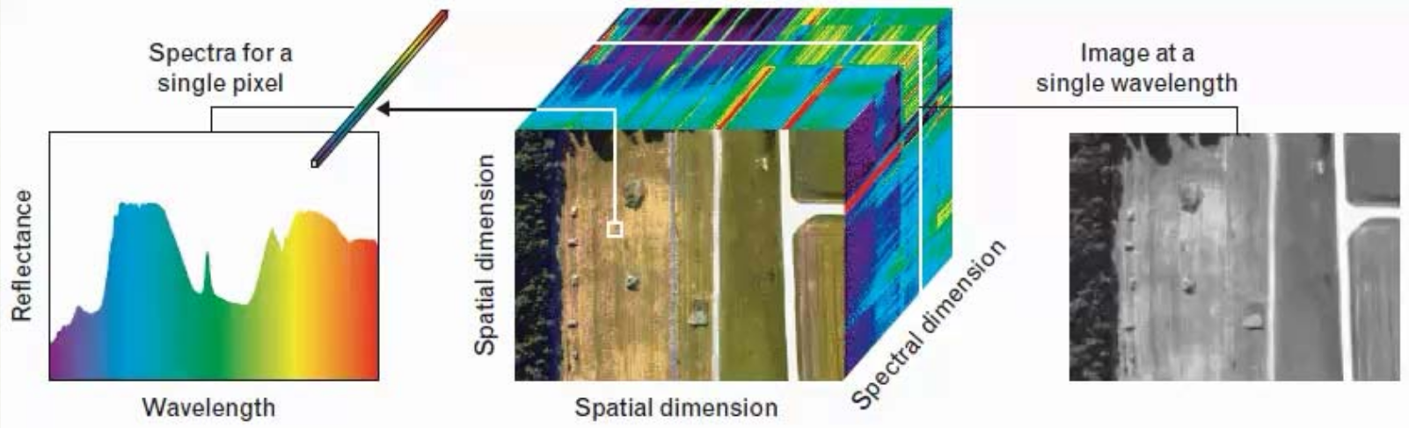
Advisor
Dr. John E. Ball
PhD, Electrical Engineering, Mississippi State University, 2007
MS, Electrical Engineering, Georgia Institute of Technology, 1993
Radar Systems
Digital Signal Processing
Digital Image Processing
Remote Sensing
Automated Target Detection
[1]
Notes:
Landon

Slide 4
Presentation Outline
Problem
Solution
System Overview
Constraints
Subsystem Testing
Integrated System Testing
Progress and Timeline
Notes:
Landon

Slide 5
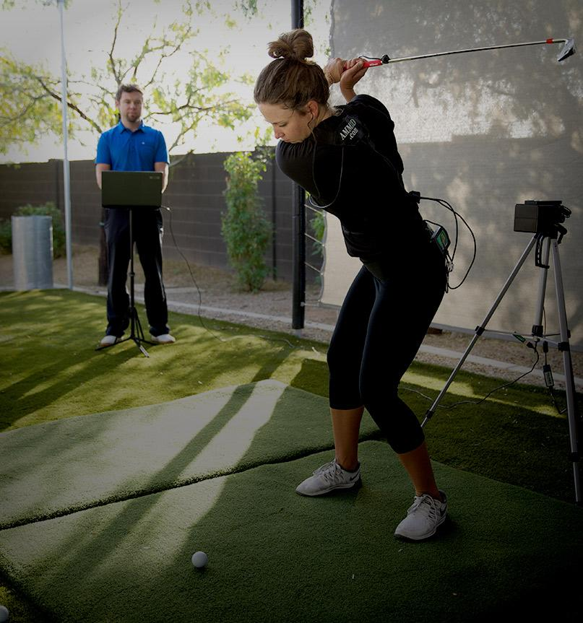
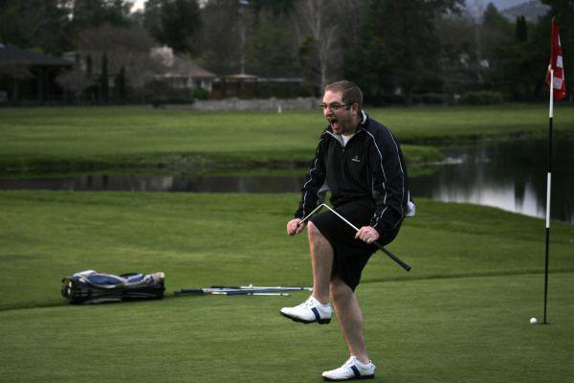
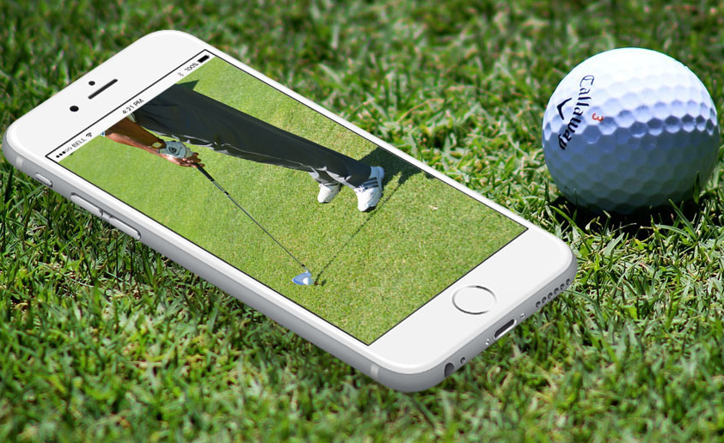
Problem Statement
Amateur Golf failures [2]
Next-generation coaching application [4]
Modern golf coaching technology [3]
Notes:
Landon
Golf has seen a recent upswing with millenials, who represent 36 percent of the nearly 24 million golfers in the United States. With 40.6 million Americans interested in golf, well over a third of that number “Around 15 million additional millennials expressed interest in taking up the game.” [x] -- https://www.cnbc.com/2017/08/12/millennials-breathing-new-life-into-golf-and-heres-how-the-industry-is-responding.html
Modern golf coaching often involves recording swings with high-speed cameras and accompanying accelerometer/position data. Performing analysis on this data is time consuming and requires a professional to be on-course reviewing the footage and giving tips.
Development has already started on the next generation of golf-swing coaching in the form of bluetooth position sensors paired with smartphone applications to give the user quick feedback based on comparing swing positioning to an ideal swing.
Golf Glove intends to build upon this approach by incorporating proprietary LiquidWire wearable stretch-sensors to measure wrist angles and correlate it with swing positioning data to provide the amateur golfer a high-resolution analysis of their swing technique.

Slide 6
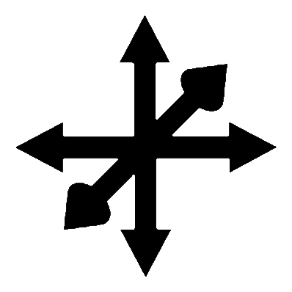
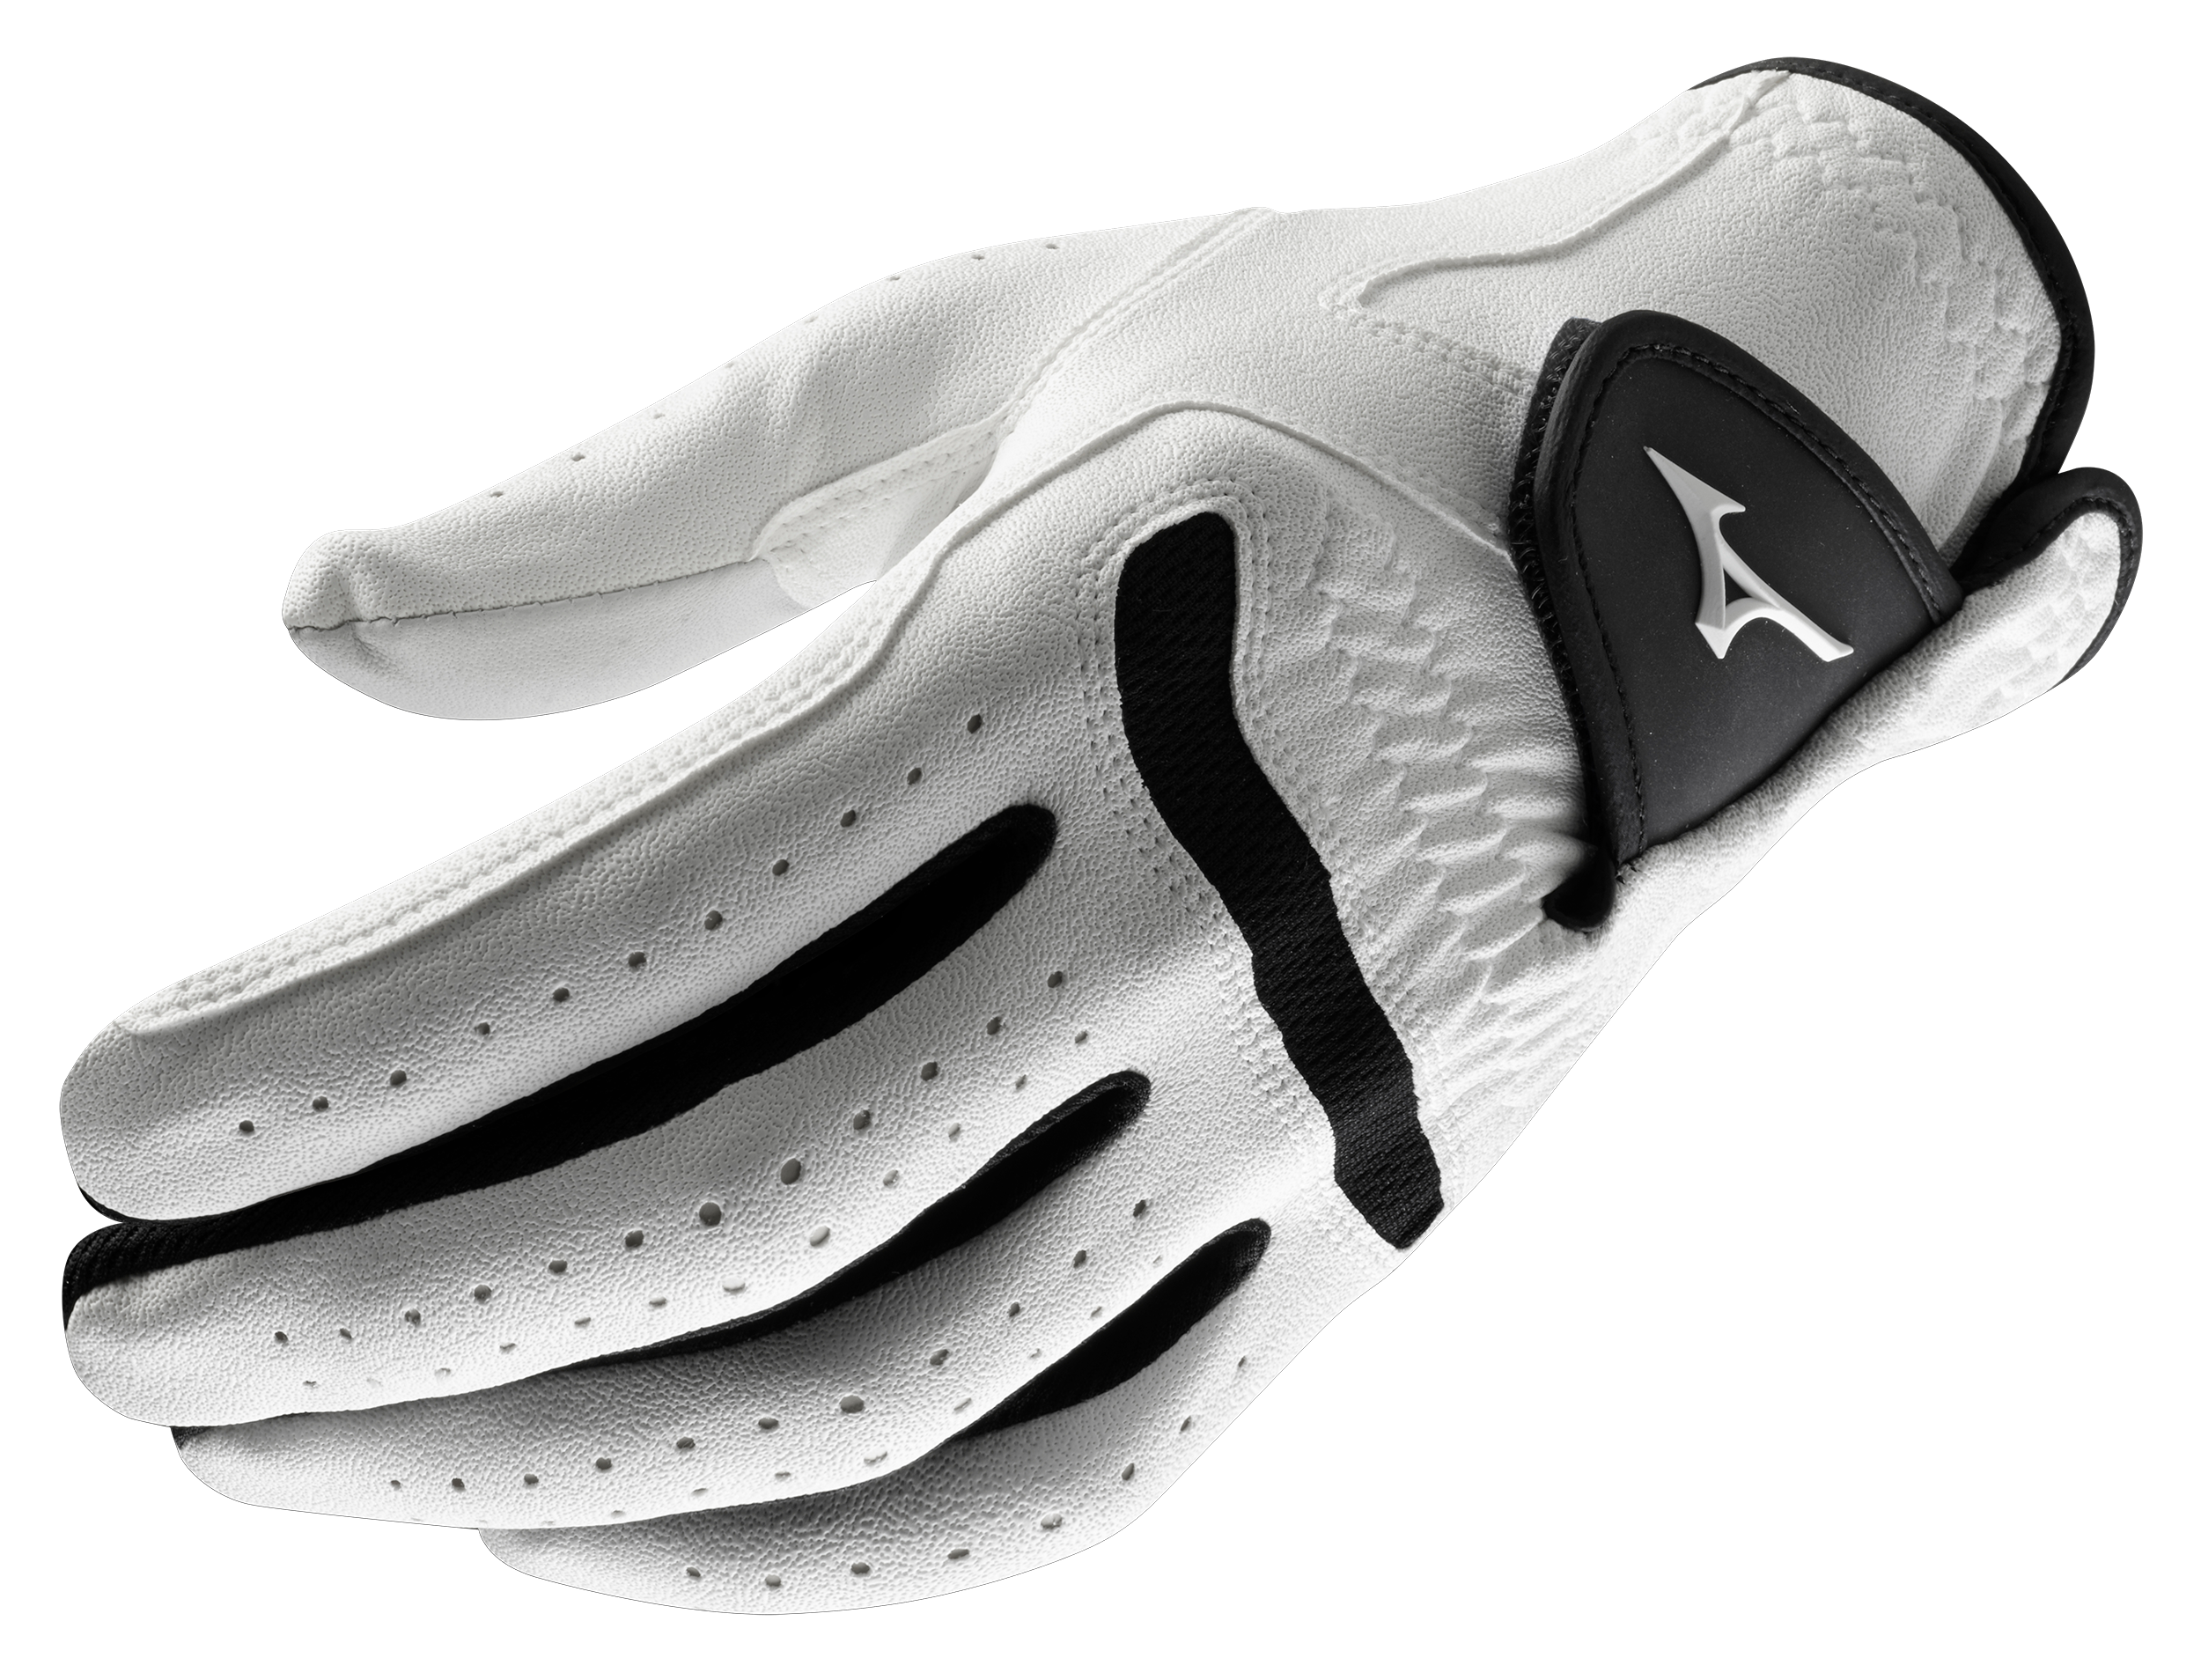
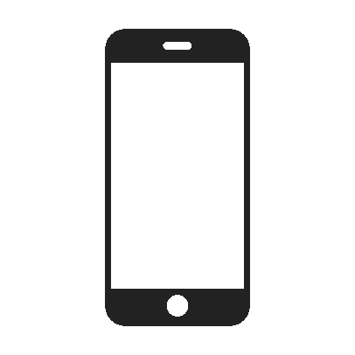

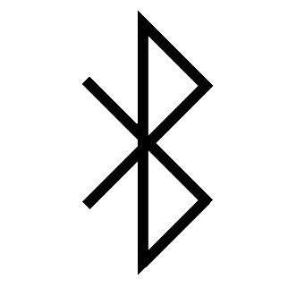

Solution
Accelerometer measures hand and club velocity through the swing
User friendly application to give intelligent swing feedback.
Gyroscopes track hand and club orientation through the swing.
BLE provides wireless transfer of coaching data.
On board battery allows for hours of runtime
Notes:
Landon
Our display must show the user’s wrist stretch and hand orientation, as well as allow the user to choose between “live” and “recorded” options.
The system must be portable: meaning no lengthy wires and powered by a battery.

Slide 7
Technical Constraints
Name | Description
Hand Orientation | Wrist flexion, extension, and deviation within 3°. Wrist acceleration, hand orientation, and hand acceleration within 5%.
Wireless Communication | Communicate Wirelessly >30 feet.
Data Display | Simple visual application that supports 120 Hz data rate.
Unobtrusive | Footprint <3 inches. Wires must not interfere with swing motion.
Portability | Battery life >5 hours.
Notes:
Christian

Slide 8

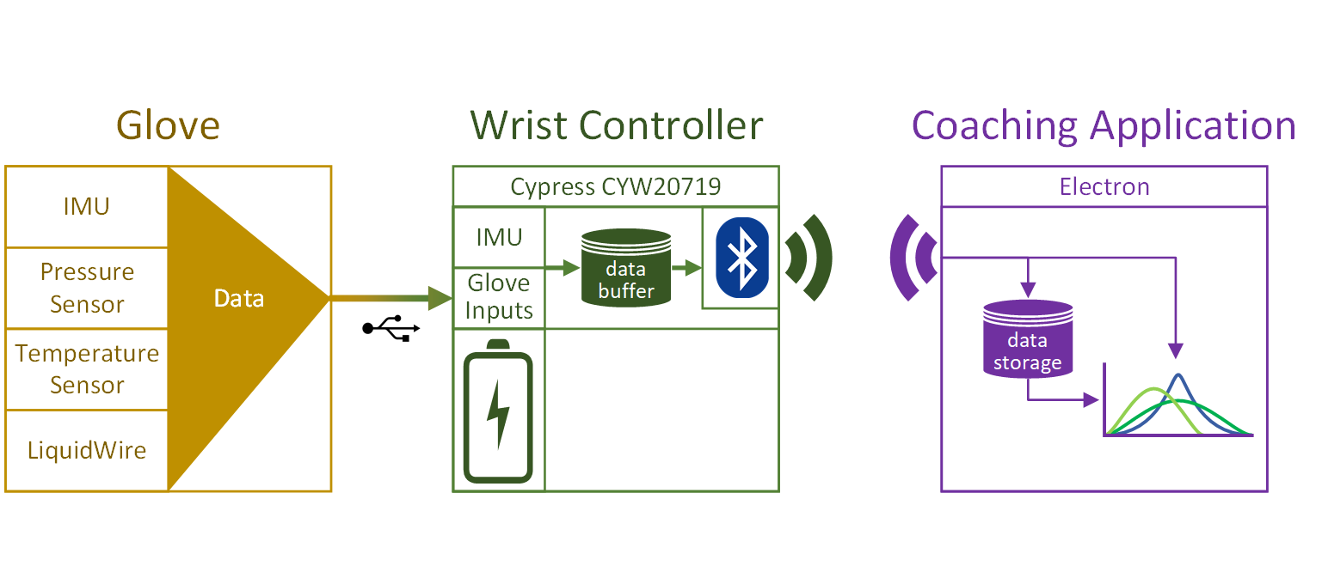
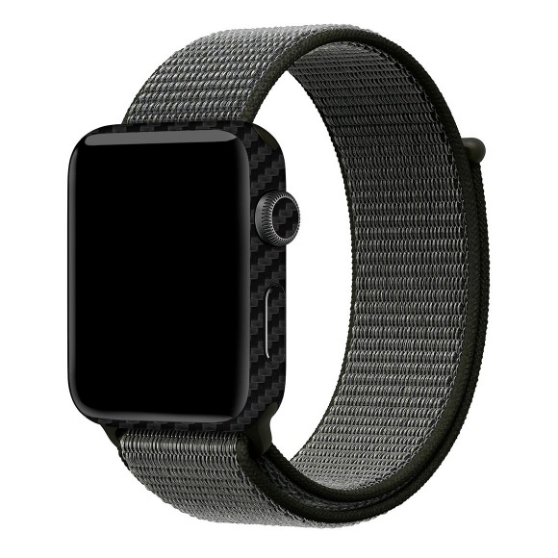
Practical Constraints
Name | Description
Manufacturability | Modular garment and wrist controller.
Environmental | The glove must be IP54 water and dust resistant.
Modular/Replaceable parts [5]
Ingress Protection Level 54 [6]
Notes:
Christian
Our system is constrained to be modular. Meaning, users with different sized hands can still benefit from the glove. And if there wrist controller breaks, it can be swapped out for a new one without modifying the entire system.
The glove and controller must also be IP54 rated, so that the user can bring their training to a course with rain and dust.

Slide 9
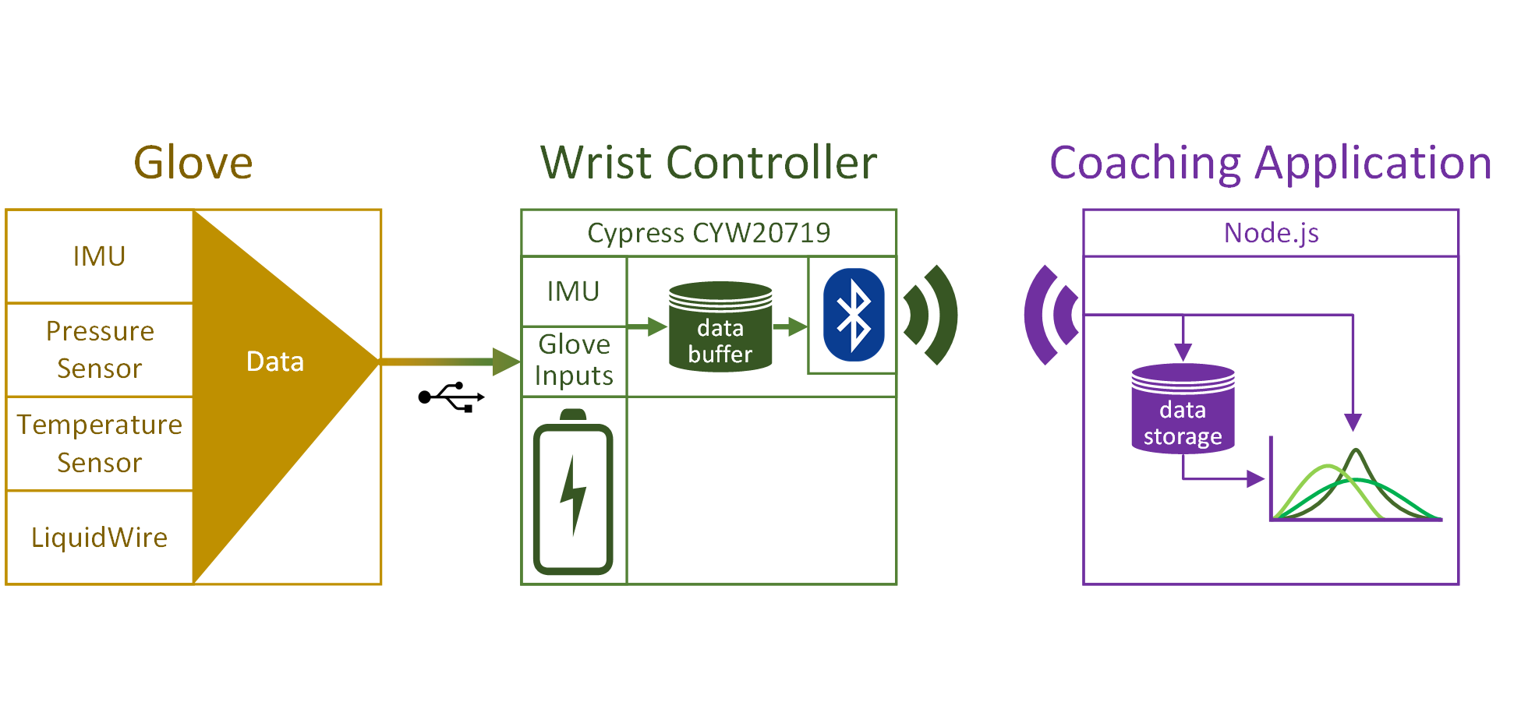
System Overview
Notes:
Spencer

Slide 10
Sensor Subsystem
Sensors
Accelerometer
Gyroscope
Pressure Sensor
Liquid Wire
Notes:
Spencer
Our display must show the user’s wrist stretch and hand orientation, as well as allow the user to choose between “live” and “recorded” options.
The system must be portable: meaning no lengthy wires and powered by a battery.

Slide 11
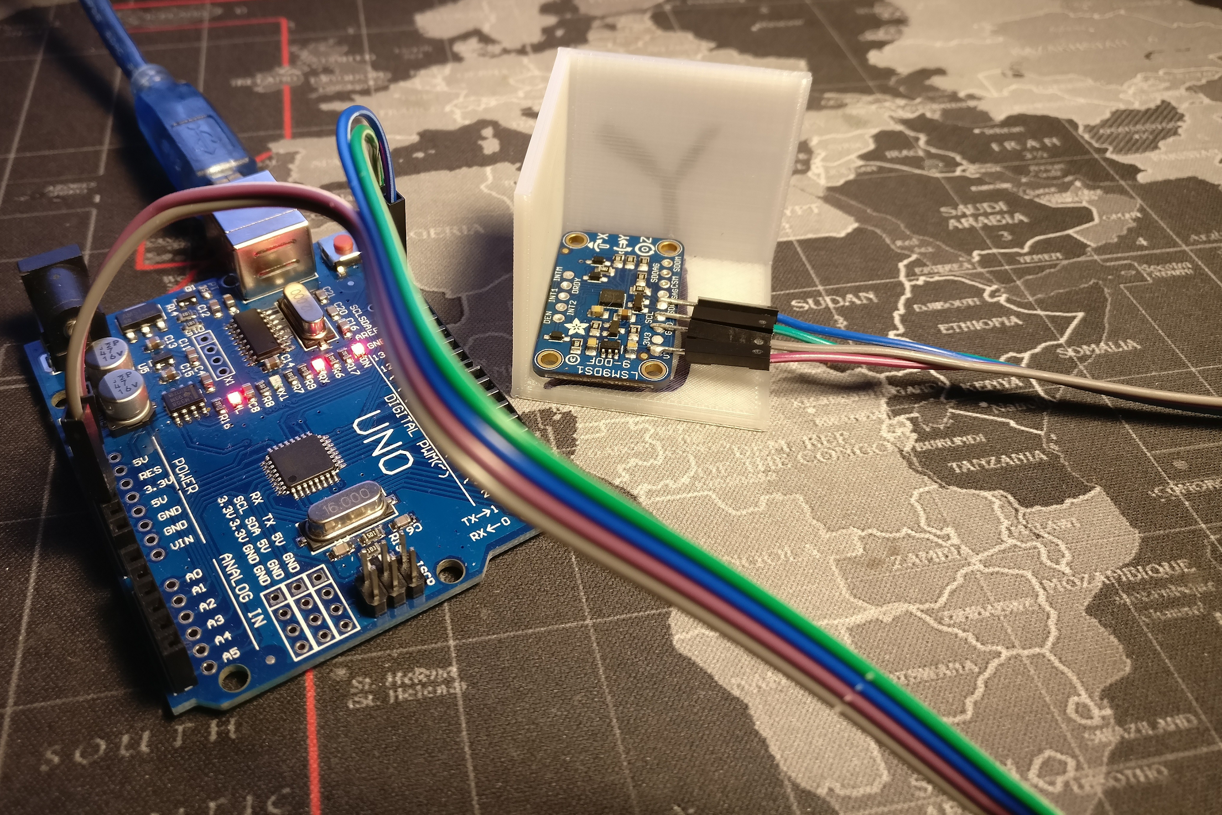
Sensor Subsystem - Accelerometer
Test | Xexp (m/s^2) | Yexp | Zexp | Xact (% err) | Yact | Zact
X-Axis | 9.8 | 0 | 0 | 10.050 (2.5%) | 0.106 | 0.374
Y-Axis | 0 | 9.8 | 0 | 0.167 | 9.786 (0.14%) | 0.894
Z-Axis | 0 | 0 | 9.8 | 0.668 | 0.159 | 10.135 (3.4%)
Resting on each axis, measuring acceleration due to gravity.
Notes:
Spencer
Our display must show the user’s wrist stretch and hand orientation, as well as allow the user to choose between “live” and “recorded” options.
The system must be portable: meaning no lengthy wires and powered by a battery.

Slide 12
Sensor Subsystem - Gyroscope
Test | Xexp (dps) | Yexp | Zexp | Xact | Yact | Zact
X-axis | 104.65 | 0 | 0 | 102.417 (2.13%) | 0.300 | 0.264
Y-axis | 0 | 104.65 | 0 | 5.101 | 101.726 (2.79%) | 6.70
Z-axis | 0 | 0 | 104.65 | 0.002 | 3.025 | 103.129 (1.45%)
90 degree movement from stepper motor over 860 ms.
Notes:
Spencer
Our display must show the user’s wrist stretch and hand orientation, as well as allow the user to choose between “live” and “recorded” options.
The system must be portable: meaning no lengthy wires and powered by a battery.

Slide 13
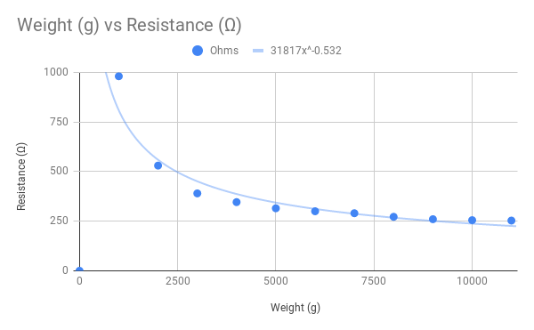
Sensor Subsystem - Pressure Sensor
Weight (g) | Measured (Ω)
0 | ∞
1000 | 980
2000 | 530
3000 | 390
4000 | 346
5000 | 315
6000 | 300
7000 | 290
8000 | 272
9000 | 260
10000 | 255
11000 | 253
Notes:
Landon
Our display must show the user’s wrist stretch and hand orientation, as well as allow the user to choose between “live” and “recorded” options.
The system must be portable: meaning no lengthy wires and powered by a battery.

Slide 14
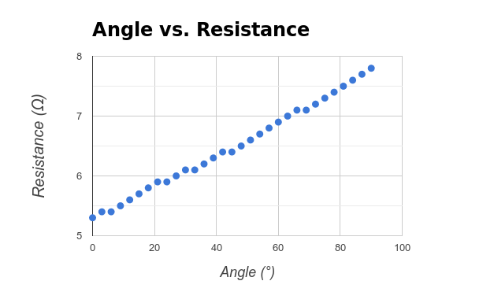
Sensor Subsystem - LiquidWire
Angle (°) | Resistance (Ω) | Angle (°) | Resistance (Ω)
0 | 5.3 | 48 | 6.5
3 | 5.4 | 51 | 6.6
6 | 5.4 | 54 | 6.7
9 | 5.5 | 57 | 6.8
12 | 5.6 | 60 | 6.9
15 | 5.7 | 63 | 7
18 | 5.8 | 66 | 7.1
21 | 5.9 | 69 | 7.1
24 | 5.9 | 72 | 7.2
27 | 6 | 75 | 7.3
30 | 6.1 | 78 | 7.4
33 | 6.1 | 81 | 7.5
36 | 6.2 | 84 | 7.6
39 | 6.3 | 87 | 7.7
42 | 6.4 | 90 | 7.8
45 | 6.4
ΔResistance (Ω) from 0° to 90° = 2.5 Ω
=> Angle (°) = 0.0278 x Resistance (Ω)
Notes:
Landon
Our display must show the user’s wrist stretch and hand orientation, as well as allow the user to choose between “live” and “recorded” options.
The system must be portable: meaning no lengthy wires and powered by a battery.

Slide 15
Wrist Controller Subsystem
Wrist-mounted Microcontroller
Battery
Sensor Polling
Bluetooth Broadcast
Notes:
Will
Our display must show the user’s wrist stretch and hand orientation, as well as allow the user to choose between “live” and “recorded” options.
The system must be portable: meaning no lengthy wires and powered by a battery.

Slide 16
Wrist Controller Subsystem - Sensor Polling
Test | Expected | Actual
Total # of Readings in 3 seconds | >= 360 frames | 4470 frames
Time to read 10000 sensor frames | <= 83.3 sec | 7 seconds
Notes:
Will
Our display must show the user’s wrist stretch and hand orientation, as well as allow the user to choose between “live” and “recorded” options.
The system must be portable: meaning no lengthy wires and powered by a battery.

Slide 17
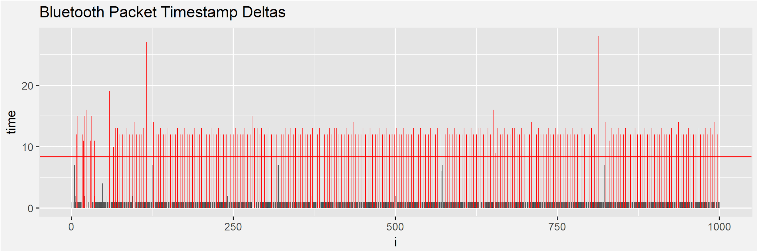
Wrist Controller Subsystem - BLE Broadcast
Constraints:
120 Hz = 1 sample per 8.33ms
Conclusion:
Avg. Broadcast Speed: 125 Hz
Notes:
Will
Our display must show the user’s wrist stretch and hand orientation, as well as allow the user to choose between “live” and “recorded” options.
The system must be portable: meaning no lengthy wires and powered by a battery.

Slide 18
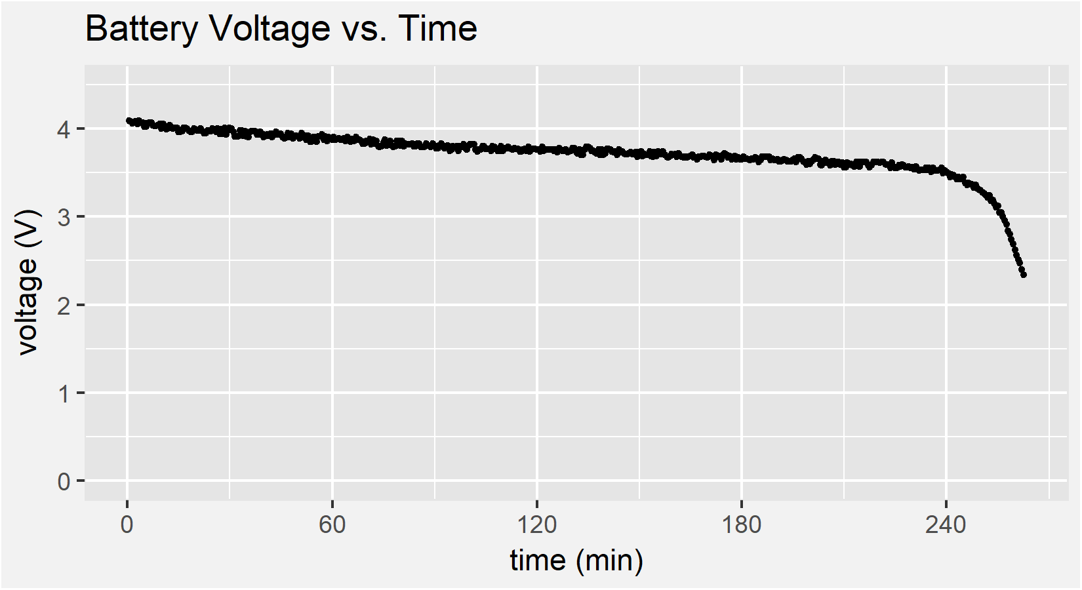
Wrist Controller Subsystem - Battery
Elapsed Time: 4.375 Hours
Avg. Current Draw: .1032 A
Capacity Utilized: 451.5 mAH
*Calculated Req. : 423.5 mAH
% Difference: 6.61%
*Calculated “Required Capacity” is minimum capacity to run device for 5 hours (.0847 Amp Draw)
Notes:
Will
Our display must show the user’s wrist stretch and hand orientation, as well as allow the user to choose between “live” and “recorded” options.
The system must be portable: meaning no lengthy wires and powered by a battery.

Slide 19
Coaching App Subsystem
Bluetooth Reception
Database
GUI
Notes:
Jack
Testing of the coaching application includes the bluetooth reception, the database performance, and the graphics

Slide 20
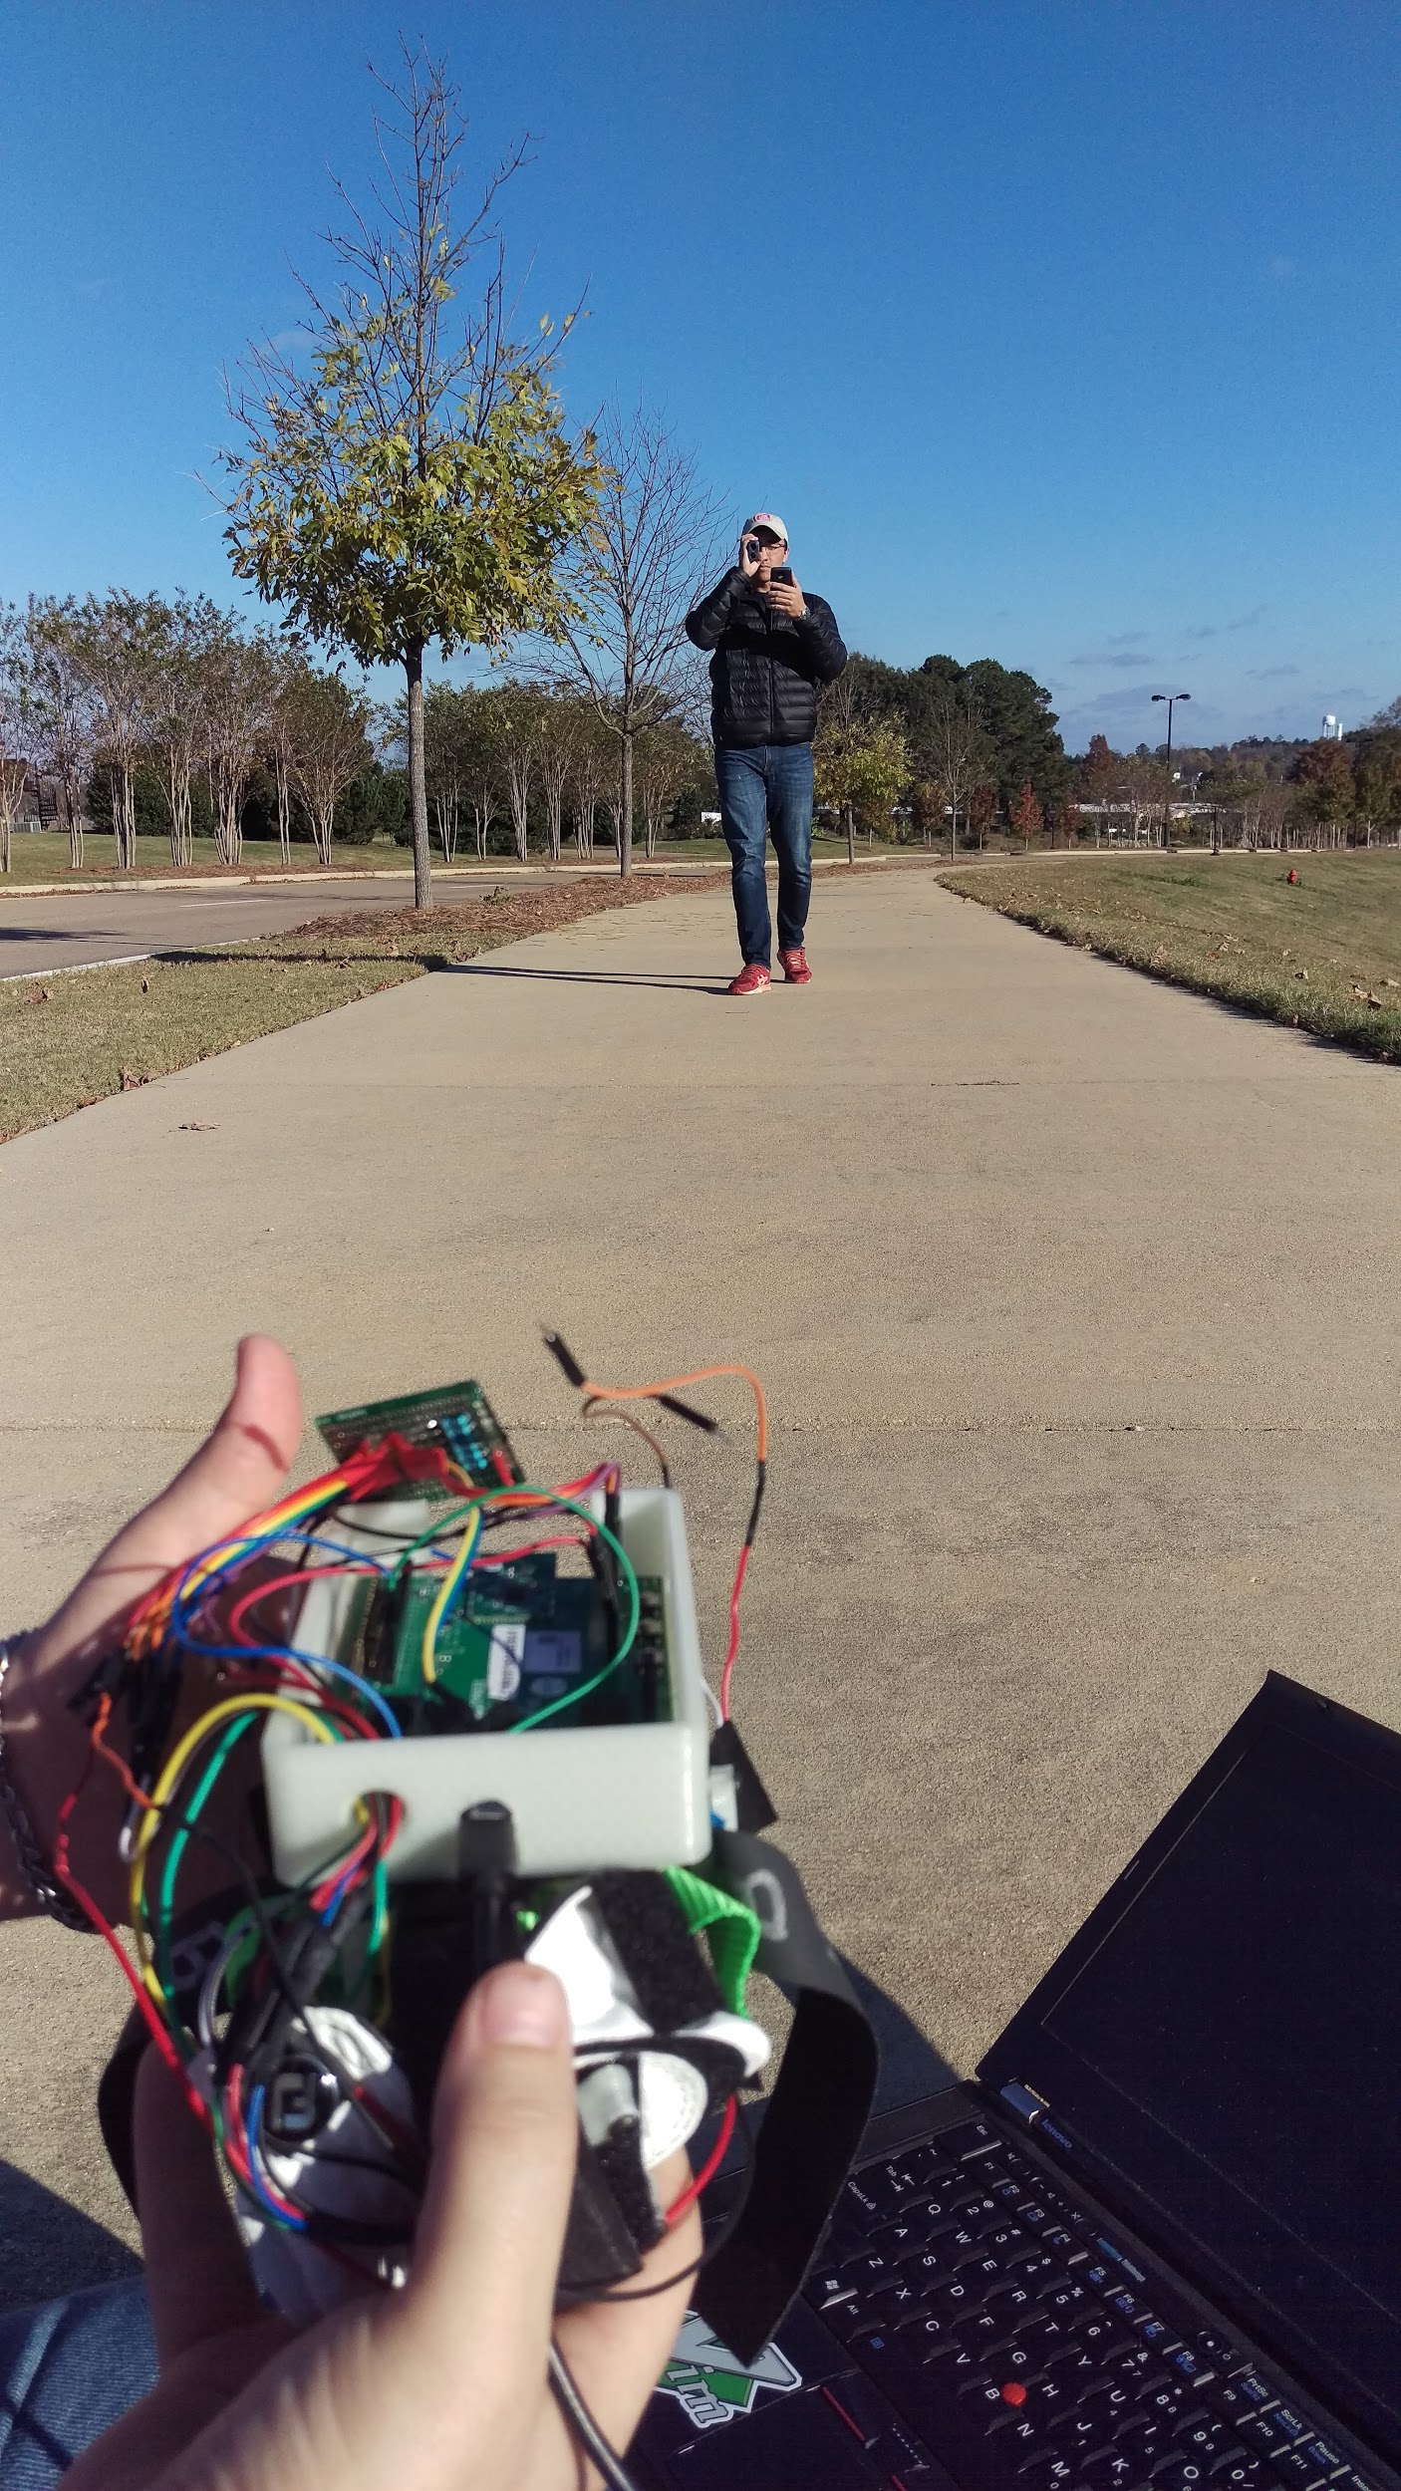
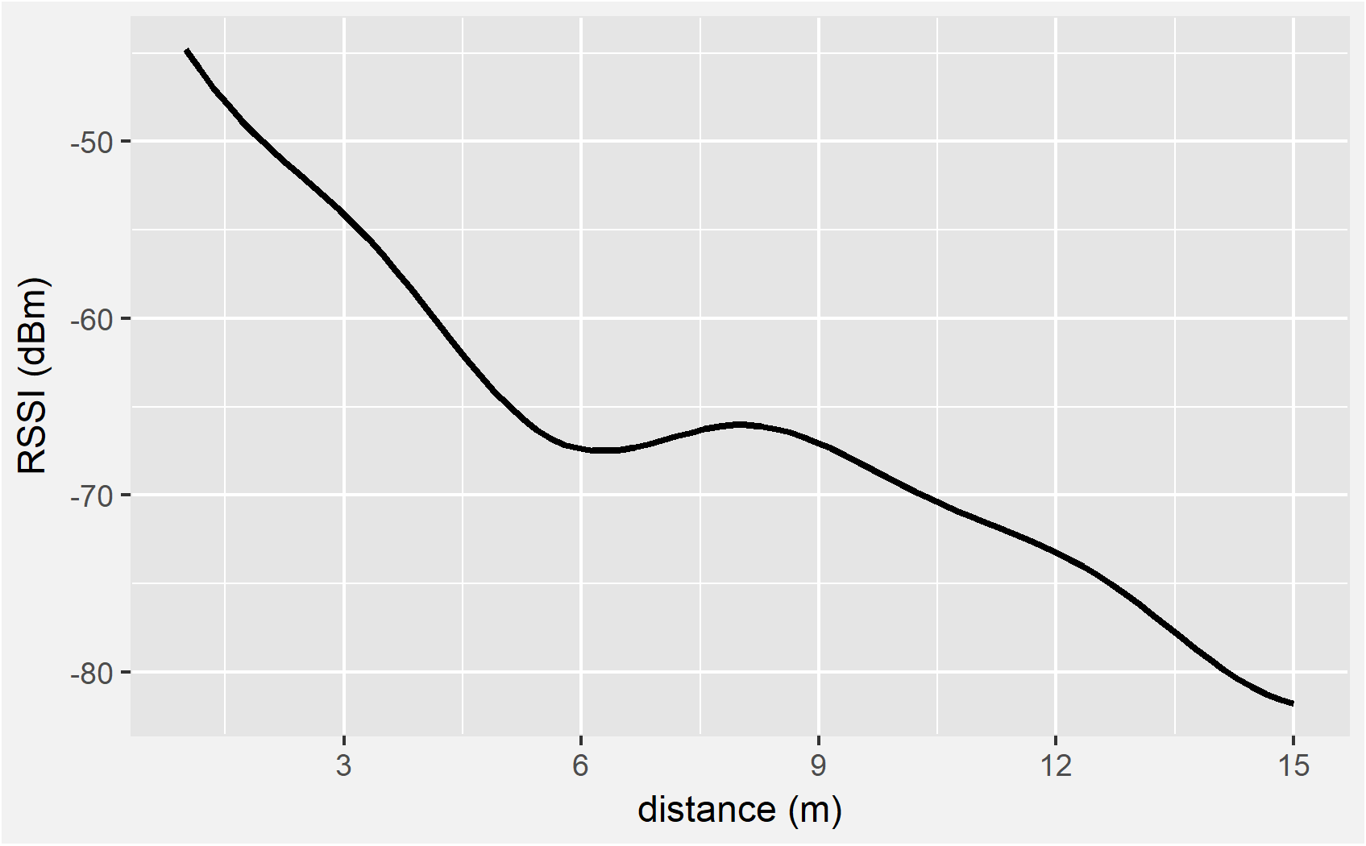
Coaching App Subsystem - BLE Reception
Notes:
Jack
The Bluetooth reception testing will have two parts: distance and accuracy.
We planned to complete the distance test with a rangefinder in an open field but weather has delayed those plans these past couple days.
We will also test the accuracy of the connection to ensure the frontend is receiving all the frames that the wrist controller sends.

Slide 21
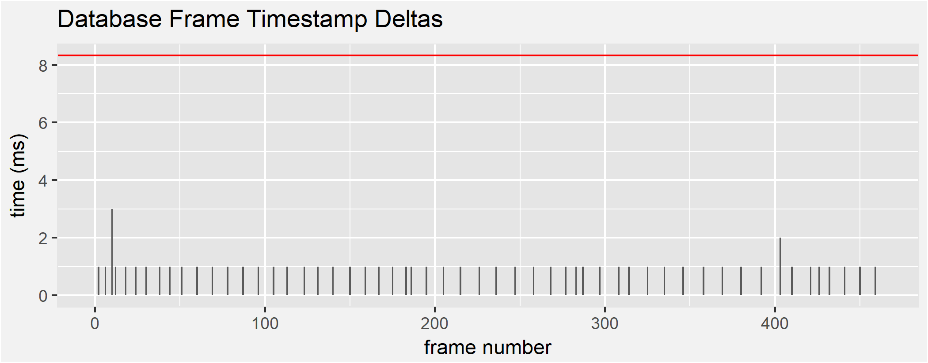
Coaching App Subsystem - Database
Constraints:
120 Hz = 1 sample per 8.33ms
Measured:
Average Write Speed: 1311 Hz
Notes:
Jack
We tested the write performance of our database to ensure 120 Hz sensor pollings can be stored, where each polling is 56 bytes in length. It was found that over 10,000 records, none had exceeded our 120 Hz constraint, and the write performance actually averaged 1.3 kHz

Slide 22
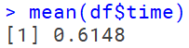
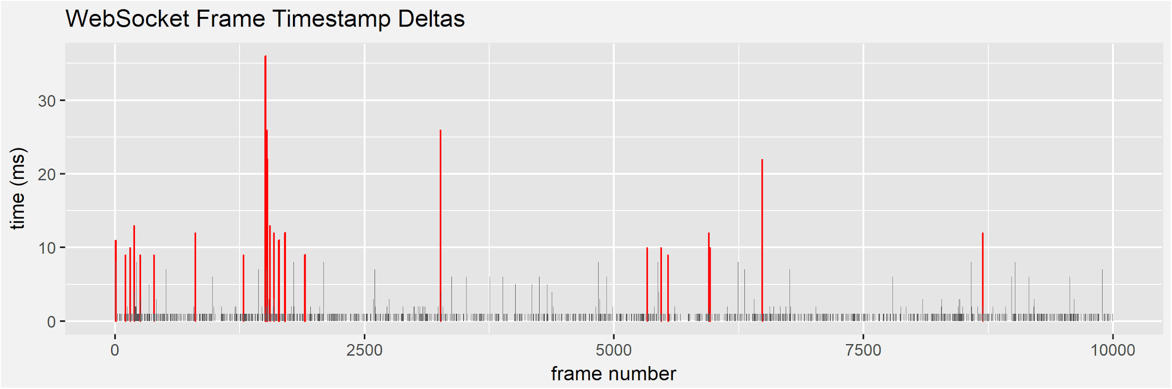
Coaching App Subsystem - WebSocket Bandwidth
Constraint: 120 Hz
Measured: 1600 Hz
Notes:
Jack
Alongside the database testing, the coaching application needs to test the backend to frontend throughput. This is the speed that the backend can send data to the frontend through the WebSocket connection. Our speed should exceed 120 Hz here too which equivalent to 0.8333 milliseconds. The delta values outlined in red are the ones that exceeded the requirement. However, this is only momentary. The application averages 0.6 milliseconds between each data frame, more than 10 times quicker than the constraint bandwidth.

Slide 23
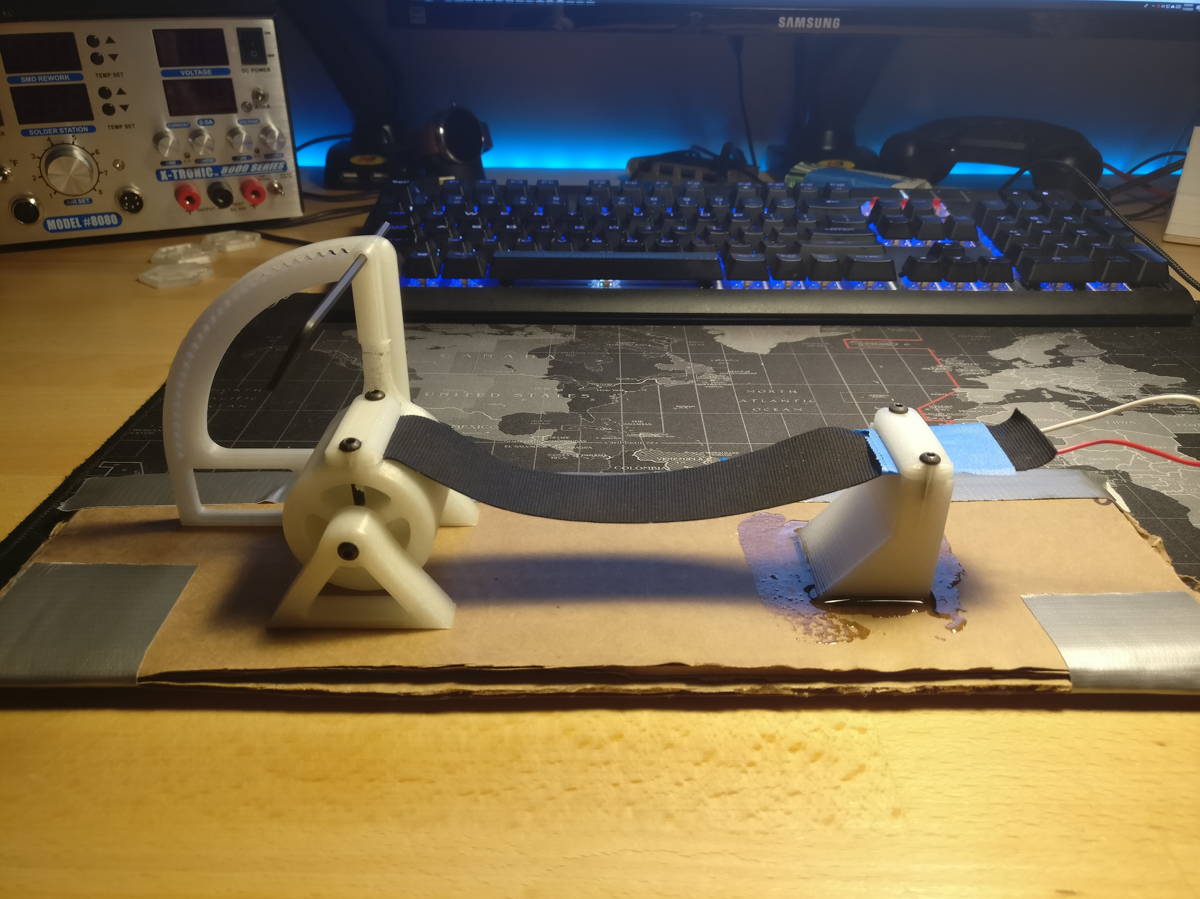
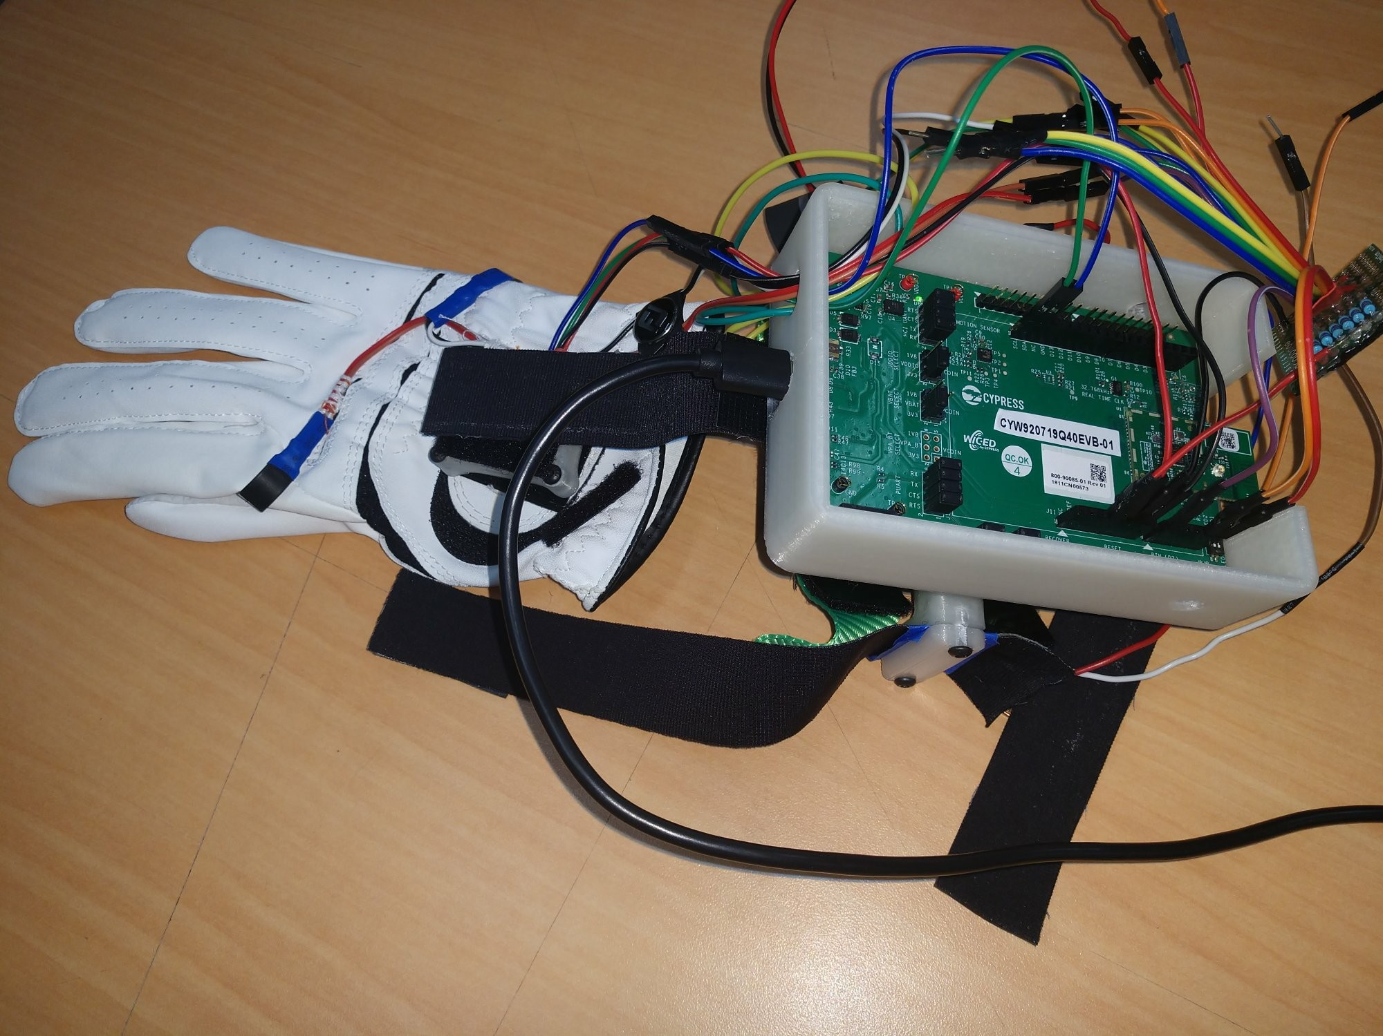

Progress
Notes:
Sensors
Mount LiquidWire, Pressure, IMU
Sensor Unit Testing
Wrist-mounted Microcontroller
BLE Broadcast
Threading Data Process/Send
Coaching Application
BLE Reception
Backend ⇔ Frontend Communication
Live Data Display

Slide 24

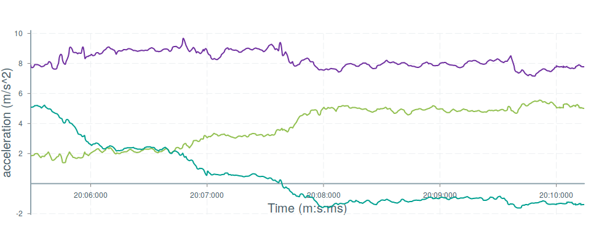
Todo
Sensors
Calibration
Wrist-mounted Microcontroller
Data Filtering
Coaching Application
Improve UI/UX
Notes:
Christian

Slide 25
Timeline
Sprint 1
Sprint 2
Sprint 3
Sprint 4
Sprint 5
Oct. 30th
Dec. 4th
Project Setup
Partial Subsystem Integration
Complete System Integration
Constraint Qualifying Tests
Improvement
Notes:
Christian
Sprint 1: Independent subsystems establish the function mimicking any required integration.
Sprint 2: Integration of the microcontroller and the glove itself. Integration of the coaching application backend to frontend.
Sprint 3: Fully integrate the Golf Glove system. Data was polled by the microcontroller and displayed on the frontend.
Sprint 4: Improve quality of data sampled. Store data. Improve the display.
Sprint 5: Completely test all the design constraints.

Slide 26
References
[1] Introduction to DSP (2018). https://mycourses.msstate.edu/bbcswebdav/pid-1559018-dt-content-rid-26818521_1/courses/jeb234.201830.Group01/Module_1.1_Introduction_Student.pdf [online].
[2] Ebaums World (2018). http://cdn.ebaumsworld.com/mediaFiles/picture/604025/84404810.jpg. [image].
[3] Exos (2018). https://www.teamexos.com/wp-content/uploads/2016/10/Hero_Capabilities_Golf.jpg. [image].
[4] Anadea (2018). https://anadea.info/uploads/image_attachment/image/1123/xCoaching_app.jpg.pagespeed.ic.eLjZbd84p6.jpg [image].
[5] Slickwraps (2018). https://www.slickwraps.com/media/catalog/product/cache/1/image/580x580/9df78eab33525d08d6e5fb8d27136e95/a/p/apple-watch-series-3_carbon_black_1.jpg [image].
[6] ProfessionalLine (2018). https://www.professionalline.com/temp/explorer/files/products/fr-CH/images/pictograms_proline_150_dpi_icon-ip54-wolke-proline.jpg [image].

Slide 27
System Overview
Notes:
Showing overview again while questions are asked.

